Slide 1
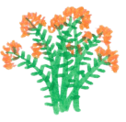
Design A Pollinator Garden Tool
Created by: www.blazingstargardens.com
Please visit our online Native Plant Store!
© Blazing Star Gardens

Slide 2
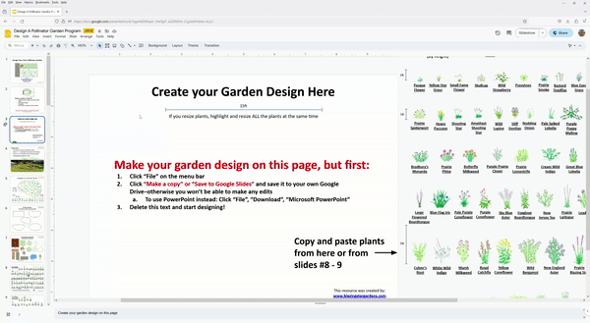
READ FIRST
BEFORE YOU CAN EDIT THIS TOOL YOU MUST DOWNLOAD IT! (see below)
You can ONLY create a design on a computer (use a library)–not a smartphone or tablet
This tool does work in PowerPoint but Google Slides is much better for seeing plant links
The button shortcuts and Table of Contents only work in Google Slides
How to Download this tool to edit it:
Click “File” on the menu bar
Have a Google Account? *Log in* and then click “Make a copy” or “Save to Google Slides” and save it to your own Google Drive–otherwise you won’t be able to make any edits
Don’t have a Google Account? Click “File”, “Download”, “Microsoft PowerPoint”
Note: If things are not working in Google Slides, download the PowerPoint version instead
Note: These drawings, graphics, and designs are for personal, non-commercial use only. These illustrations are solely for non-commercial home use. No license or permission has been granted to use these illustrations and graphics in commercial landscape design work, garden businesses, printed or digital publications, websites, or physical articles which will thereafter be sold. Any such use is an infringement on the copyright and is strictly prohibited. This design tool can be used in an educational setting only with written permission that can be requested the creator: info@blazingstargardens.com.

Slide 3
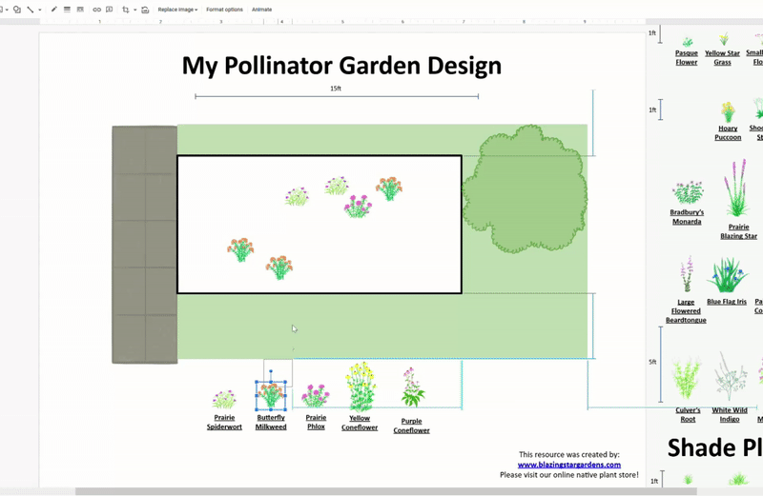
Table of Contents
Slides for Making a Garden Design:
Slide 4: Design Your Garden Here!
Slide 5: Add garden shapes
Slide 6: Add landscape elements
Slide 7: Create-a-Plant
Slide 8: Helpful computer tips
Resource and Learning Slides:
Slide 9: Garden design basics
Slides 10 - 12: Garden design examples
Slides 13 - 14: Sun and Shade plants with scientific names
Slides 15 - 16: Dry or Wet plants
Slides 17 - 18: How much do plants spread in gardens?
Slide 19: Plants for clay soil
Slides 20 - 23: Companion Plants; Plants that go well together.
Slides 24 - 34: Blooms charts!
Slide 35: Site Preparation and planting instructions
Slides 36+: More garden design examples
This resource was created by: www.blazingstargardens.com
Please visit our online native plant store!

Slide 4
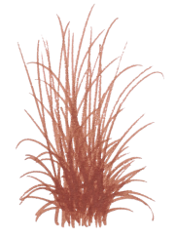
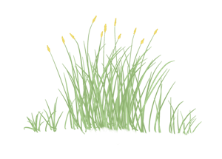
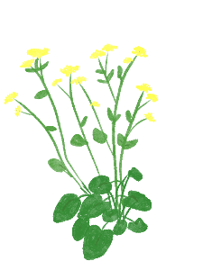
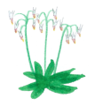
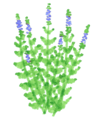
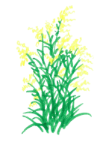
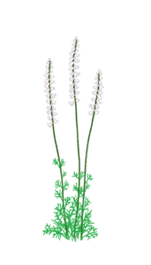
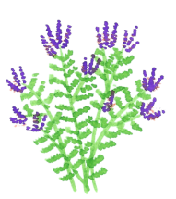
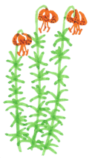
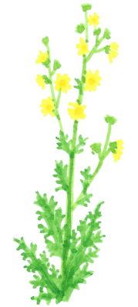
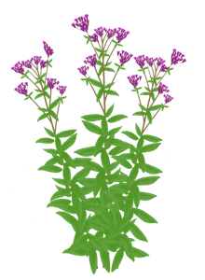
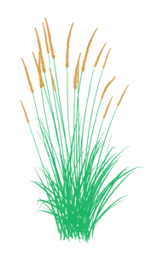
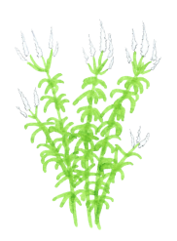
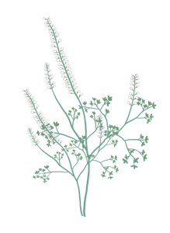
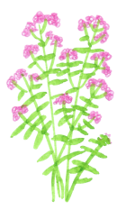
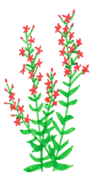
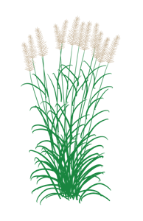
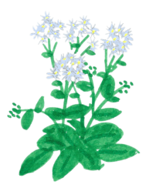
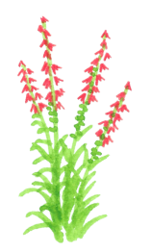
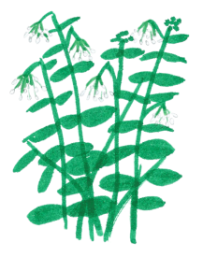
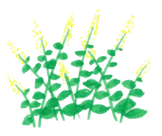
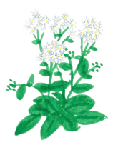
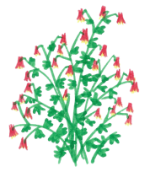
Garden Design
Sun Plants:
(by height)
Parasol Sedge
Blue Grama Grass
Mead’s Sedge
Star Sedge
Fox Sedge
Side Oats Grama
Prairie Dropseed
Little Bluestem
Little Bluestem (fall color)
MORE THAN 6 hours direct sunlight each day
1ft
Create Your Garden Design Here
Pasque Flower
Yellow Star Grass
Small Fame Flower
Skullcap
Wild
Strawberry
Pussytoes
Prairie
Smoke
Bastard Toadflax
Blue Eyed Grass
Ground Plum
Harebell
Wood Betony
Prairie
Lily
Snakeroot
Fringed Puccoon
Dotted Blazing Star
15ft
The plant illustrations are currently sized realistically for this 15ft wide scale. If you resize the plants, highlight and resize ALL plants at the same time.
1ft
Prairie Spiderwort
Hoary Puccoon
Shooting Star
Amethyst
Shooting Star
Wild
Lupine
Stiff Gentian
Nodding Onion
Pale Spiked Lobelia
Purple Poppy Mallow
Bradbury’s Monarda
Narrow Leaf Coneflower
Whorled Milkweed
Thimble-weed
Heart Leaved Golden Alexanders
Cream Gentian
Bottle Gentian
Prairie Coreopsis
Share your design on social media!
Bradbury’s Monarda
Prairie Phlox
Butterfly Milkweed
Purple Prairie Clover
Prairie Loosestrife
Cream Wild Indigo
Great Blue Lobelia
Blanket Flower
Aromatic Aster
Hoary
Vervain
Lance Leaf Coreopsis
Grey Goldenrod
Orange Coneflower
Large Flowered Beardtongue
Blue Flag Iris
Pale Purple Coneflower
Purple Coneflower
Sky Blue Aster
Foxglove Beardtongue
New Jersey Tea
Prairie Larkspur
Lead Plant
Blue Wild Indigo
Blue Vervain
Common Milkweed
Prairie Milkweed
Michigan Lily
Rattlesnake Master
Rough Blazing Star
Copy and paste plants from here
5ft
Culver’s Root
White Wild Indigo
Marsh Milkweed
Royal Catchfly
Yellow Coneflower
Wild Bergamot
New England Aster
Prairie Blazing Star
Meadow Blazing Star
Indian Grass
Joe Pye Weed
Ironweed
Big Bluestem
Compass Plant
15ft
This resource was created by: www.blazingstargardens.com
Please visit our online native plant store!
Shade Plants:
(by height)
LESS THAN 46 hours direct sunlight each day
1ft
Ivory
Sedge
Pennsylvania Sedge
Rosy
Sedge
Star
Sedge
Palm Sedge
Bur
Sedge
Bottlebrush
Grass
Marsh
Marigold
Jacob’s Ladder
Harebell
Wood Betony
Wild Blue Phlox
Bradbury’s Monarda
Jack-in-the-pulpit
Wild Geranium
Zig Zag Goldenrod
Big Leaf Aster
Columbine
Short’s Aster
Michigan Lily
Cardinal Flower
Poke Milkweed
Sweet Joe Pye Weed
Notes:
Create your garden design on this page

Slide 5
Garden Shapes
Copy and paste to Garden Design. Resize as needed.
To create your own shape, click Insert → Line → Scribble

Slide 6
Landscape Elements
Landscape Elements
Copy and paste to Garden Design
Lawn
Trees
House
Bench
Fence
Rock
Deck
Shrub
Sidewalk or Driveway
Pond

Slide 7
Create-a-Plant
Do you need a species we haven’t drawn yet? Create that species below
How to make a missing species - Example: Stiff Goldenrod
STEP 1
Search for a picture of the plant you need
STEP 2
Pick similar shapes from the flower and plant shapes below
STEP 3
Copy flowers, resize, and arrange
STEP 4
Highlight everything, right click, then select “Group”
STEP 5
Find out how tall the plant is and adjust it to this scale:
2.5ft
1ft
Butterfly Milkweed
Determine the flower shape
Determine the plant shape
Make the plant here
Then copy it to your garden design
© Blazing Star Gardens

Slide 8
Computer Tips
Helpful Computer Tips:
Don’t have a computer? Sketch your garden design on paper while using the resource slides to figure out how to design. Then, use the computers at your local library to transfer your design onto this design tool. Libraries have nice color printers, too! (Pro tip: Put the printed garden design in those plastic sleeves made for 3-ring binders so it doesn’t get muddy while planting)
To make new garden shape: Click “Insert” on menu bar and then “Scribble” or the shape of your choice to draw your garden border (then go to “Format”, “Shape Fill” and click “No fill”; then click “Shape Outline” and change to black or other color)
Add plants: Highlight the flowers and grasses you want and move them to your design.
Use Copy and Paste to make more of each plant
Holding Ctrl+C and Ctrl+V copies and pastes on google slides
Fast Copying: Holding Ctrl while moving a plant creates a duplicate. This is a great way to add copies where you want.
Order/overlap plants and elements: Is a plant or landscape element blocking another? You can change how items overlap each other by right-clicking and selecting “Order”, then “Send backward/forward”.
Resize plants: Hold down the Shift key while adjusting the corner dots to preserve shape
To rotate a plant or element: Highlight item and then click and move the green dot above it to rotate
To save a copy of your design for sharing: Click “File” on menu bar and then “Download”. Then choose “PNG image”, “JPEG image”, or “PDF”. When a box opens up, click “Save current slide only”. Saving as a PDF file makes the image less grainy than saving as a PNG or JPEG, but it does save the entire slideshow.
To print: Clicking “File” on the menu bar and then “Print” will save a .PDF file to your computer, which you then have to print. Select “Current Page” to only print the first page–your design.

Slide 9
Design Basics
Short plants on border, tall plants in middle
About 12” - 15” spacing for everything. Plant in groups for max color.
Wet or dry, sun or shade? (check Sun/Shade, Wet/Dry slides)
Something blooming every month (check Bloom Chart slides)
Be careful planting big plants that spread and outcompete small plants
TALL 3-6ft
SHORT 1-3ft
VERY SHORT <1ft
SHORT 1-3ft
VERY SHORT <1ft

Slide 10
Garden Examples
Example: Sunny Pollinator Garden
15ft
Grasses and Sedges to mix throughout garden:
Star Sedge
12 plants
Prairie Dropseed
6 plants
Shorter plants near borders or front of garden
Taller plants near middle or back of garden
Prairie Pussytoes
3 plants
Nodding Onion
3 plants
Bradbury’s Monarda
3 plants
Butterfly Milkweed
6 plants
Prairie Phlox
3 plants
Aromatic Aster
1 plant
Blanket Flower
3 plants
Lance Leaf Coreopsis
3 plants
Grey Goldenrod
3 plants
Orange Coneflower
3 plants
Pale Purple Coneflower
3 plants
Blue Wild Indigo
2 plants
Culver’s Root
3 plants
Cardinal Flower
3 plants
Meadow Blazing Star
12 plants

Slide 11
Example: Front Yard Shady Garden
15ft
Taller plants in the middle of the garden
Plants next to sidewalks need to be VERY short. Even 2ft tall plants will flop over and obstruct paths!
Ivory
Sedge
Star
Sedge
Wood Betony
Harebell
Jacob’s Ladder
Wild Blue Phlox
Bradbury’s Monarda
Orange Coneflower
Cardinal Flower
Notes:
This garden example shows a house with a front sidewalk. The species are very short to account for sidewalks and walking paths, where plants need to be less than 2ft tall to prevent from flopping over into walkways. The species in this design don’t spread very much and aren’t known to “take over” gardens. It’s planted in a more natural design style with plants mixed up and not in pure groups–this style takes into account plants spreading or dying. The species that were not chosen are as important as the ones that were. Sweet Joe Pye Weed? Too tall for this situation. Big Leaf Aster or Zig Zag Goldenrod? Spread too much and would take over the more conservative species. Every location needs to be carefully considered, and a front yard or boulevard garden probably needs to be as short and intentional looking as possible. The plants that weren’t chosen might do better in a backyard wild garden or a woodland restoration project.

Slide 12
Example: Backyard Wild Sunny Garden
15ft
Deck
Grey Goldenrod
Heart Leaved Golden Alexanders
Culver’s Root
White Wild Indigo
Marsh Milkweed
Yellow Coneflower
Wild Bergamot
New England Aster
Prairie Blazing Star
Rattlesnake Master
Compass Plant
Notes:
This garden example shows a house with a sunny backyard. The species are tall and known to spread, which this person wants because they want lower-maintenance plants that can outcompete smaller weeds. The species in this design spread a lot by seed. It’s planted in a more natural design style with plants mixed up and not in pure groups–this style takes into account plants spreading or dying. The species that were not chosen are as important as the ones that were. Prairie smoke or Pasque Flower? Too small and would get crowded out in a few years. Every location needs to be carefully considered, and a backyard is a great place for putting in a garden that can be as tall and wild as you want it. These plants also might do well in a garden that doesn’t have as careful of site preparation, and might survive among lawn grass.

Slide 13
Sun/Shade Plants
Sun Plants:
(in order by scientific name)
MORE THAN 6 hours direct sunlight each day
1ft
Nodding Onion (Allium cernuum)
Prairie Onion (Allium stellatum)
Lead Plant (Amorpha canescens)
Thimbleweed (Anemone cylindrica)
Pasque Flower (Anemone patens)
Pussytoes (Antennaria neglecta)
Marsh Milkweed (Asclepias incarnata)
Prairie Milkweed (Asclepias sullivantii)
Common Milkweed (Asclepias syriaca)
Butterfly Milkweed (Asclepias tuberosa)
Whorled Milkweed (Asclepias verticillata)
5ft
New England Aster (Aster novae-angliae)
Aromatic Aster (Aster oblongifolius)
Sky Blue Aster (Aster oolentangiense)
Ground Plum (Astragalus crassicarpus)
White Wild Indigo (Baptisia alba)
Blue Wild Indigo (Baptisia australis)
Cream Wild Indigo (Baptisia bracteata)
Purple Poppy Mallow (Callirhoe involucrata)
Harebell (Campanula rotundifolia)
New Jersey Tea (Ceanothus americanus)
Bastard Toadflax (Comandra umbellata)
Lance Leaf Coreopsis (Coreopsis lanceolata)
Prairie Coreopsis (Coreopsis palmata)
Purple Prairie Clover (Dalea purpurea)
Prairie Larkspur (Delphinium virescens)
Amethyst
Shooting Star (Dodecatheon amethystinum)
Shooting Star (Dodecatheon meadia)
Narrow Leaf Coneflower (Echinacea angustifolia)
Purple Coneflower (Echinacea purpurea)
Pale Purple Coneflower (Echinacea pallida)
Rattlesnake Master (Eryngium yuccifolium)
Joe Pye Weed (Eupatorium maculatum)
Wild
Strawberry (Fragaria virginiana)
Blanket Flower (Gaillardia aristata)
Bottle Gentian (Gentiana andrewsii)
Cream Gentian (Gentiana flavida)
Stiff Gentian (Gentianella quinquefolia)
Prairie
Smoke (Geum triflorum)
Yellow Star Grass (Hypoxis hirsuta)
Blue Flag Iris (Iris versicolor)
Rough Blazing Star (Liatris aspera)
Meadow Blazing Star (Liatris ligulistylis)
Dotted Blazing Star (Liatris punctata)
Prairie Blazing Star (Liatris pycnostachya)
Michigan Lily (Lilium michiganense)
Prairie
Lily (Lilium philadelphicum)
Hoary Puccoon (Lithospermum canescens)
Fringed Puccoon (Lithospermum incisum)
Great Blue Lobelia (Lobelia siphilitica)
Pale Spiked Lobelia (Lobelia spicata)
Wild
Lupine (Lupinus perennis)
Prairie Loosestrife (Lysimachia quadriflora)
Bradbury’s Monarda (Monarda bradburiana)
Wild Bergamot (Monarda fistulosa)
Wood Betony (Pedicularis canadensis)
Foxglove Beardtongue (Penstemon digitalis)
Large Flowered Beardtongue (Penstemon grandiflorus)
Prairie Phlox (Phlox pilosa)
Snakeroot (Polygala senega)
Yellow Coneflower (Ratibida pinnata)
Orange Coneflower (Rudbeckia fulgida)
Skullcap (Scutellaria leonardii)
Royal Catchfly (Silene regia)
Blue Eyed Grass (Sisyrinchium campestre)
Grey Goldenrod (Solidago nemoralis)
Small Fame Flower (Talinum parviflorum)
Prairie Spiderwort (Tradescantia bracteata)
Note: These drawings, graphics, and designs are for personal, non-commercial use only. These illustrations are solely for non-commercial home use. No license or permission has been granted to use these illustrations and graphics in commercial landscape design work, garden businesses, printed or digital publications, websites, or physical articles which will thereafter be sold. Any such use is an infringement on the copyright and is strictly prohibited.
Compass Plant (Silphium laciniatum)
© Blazing Star Gardens

Slide 14
Shade Plants: (in order of scientific name)
Sun Plants continued: (in order of scientific name)
MORE THAN 6 hours direct sunlight each day
Blue Vervain (Verbena hastata)
Hoary
Vervain (Verbena stricta)
Culver’s Root Veronicastrum virginicum)
Heart Leaved Golden Alexanders (Zizia aptera)
Ironweed (Vernonia fasciculata)
1ft
Big Bluestem (Andropogon gerardii)
Side Oats Grama (Bouteloua curtipendula)
Blue Grama Grass (Bouteloua gracilis)
Mead’s Sedge (Carex meadii)
Star Sedge (Carex radiata)
Parasol Sedge (Carex umbellata)
Fox Sedge (Carex vulpinoidea)
Little Bluestem (Schizachyrium scoparius)
Little Bluestem (Schizachyrium scoparius)
Indian Grass (Sorghastrum nutans)
Prairie Dropseed (Sporobolus heterolepis)
LESS THAN 4-6 hours direct sunlight each day
5ft
Columbine (Aquilegia canadensis)
Jack-in-the-pulpit (Arisaema triphyllum)
Poke Milkweed (Asclepias exaltata)
Big Leaf Aster (Aster macrophyllus)
Short’s Aster (Aster shortii)
Marsh
Marigold (Caltha palustris)
Harebell (Campanula rotundifolia)
Sweet Joe Pye Weed (Eupatorium purpureum)
Wild Geranium (Geranium maculatum)
Michigan Lily (Lilium michiganense)
Cardinal Flower (Lobelia cardinalis)
Bradbury’s Monarda (Monarda bradburiana)
Wood Betony (Pedicularis canadensis)
Wild Blue Phlox (Phlox divaricata)
Jacob’s Ladder (Polemonium reptans)
Zig Zag Goldenrod (Solidago flexicaulis)
Ivory
Sedge (Carex eburnea)
Bur
Sedge (Carex grayi)
Palm Sedge (Carex muskingumensis)
Pennsylvania Sedge (Carex pensylvanica)
Rosy
Sedge (Carex rosea)
Star
Sedge (Carex radiata)
Bottlebrush
Grass (Elymus hystrix)
Note: These drawings, graphics, and designs are for personal, non-commercial use only. These illustrations are solely for non-commercial home use. No license or permission has been granted to use these illustrations and graphics in commercial landscape design work, garden businesses, printed or digital publications, websites, or physical articles which will thereafter be sold. Any such use is an infringement on the copyright and is strictly prohibited.
© Blazing Star Gardens

Slide 15
Sun/Shade Plants
Dry/Wet Plants
Sunny Plants
MORE THAN 6 hours direct sunlight each day
Drier
Pasque Flower
Blue Grama Grass
Pussytoes
Small Fame Flower
Prairie
Smoke
Sandy soil, well-drained, never standing water
Dotted Blazing Star
Side Oats Grama
Narrow Leaf Coneflower
Purple Poppy Mallow
Little Bluestem
Little Bluestem (fall color)
Blue Eyed Grass
Ground Plum
Harebell
Fringed Puccoon
Shooting Star
Wild
Lupine
Stiff Gentian
Nodding Onion
Pale Spiked Lobelia
Prairie
Lily
Cream Wild Indigo
Large Flowered Beardtongue
Prairie Dropseed
Lead Plant
Rough Blazing Star
Parasol Sedge
Star Sedge
Butterfly Milkweed
Purple Prairie Clover
Whorled Milkweed
Thimble-weed
Grey Goldenrod
Blanket Flower
Aromatic Aster
Hoary
Vervain
Lance Leaf Coreopsis
Pale Purple Coneflower
Sky Blue Aster
Yellow Star Grass
Skullcap
Wild
Strawberry
Wood Betony
Bastard Toadflax
Hoary Puccoon
Snakeroot
Amethyst
Shooting Star
Bradbury’s Monarda
Purple Coneflower
Royal Catchfly
Rattlesnake Master
White Wild Indigo
Compass Plant
Prairie Spiderwort
Cream Gentian
Prairie Phlox
Prairie Loosestrife
Heart Leaved Golden Alexanders
Prairie Coreopsis
Prairie Larkspur
New Jersey Tea
Common Milkweed
Wild Bergamot
Yellow Coneflower
Big Bluestem
Indian Grass
No more than 1-2 days in standing water
Mead’s Sedge
Great Blue Lobelia
Bottle Gentian
Orange Coneflower
Foxglove Beardtongue
Prairie Milkweed
Michigan Lily
Blue Wild Indigo
Culver’s Root
Meadow Blazing Star
Prairie Blazing Star
Wetter
Heavier soil, not as well drained
No more than 2-5 days in standing water
Blue Vervain
Marsh Milkweed
New England Aster
Joe Pye Weed
© Blazing Star Gardens
Fox Sedge
Blue Flag Iris
Ironweed

Slide 16
Shade Plants
Drier
LESS THAN 4-6 hours direct sunlight each day
Ivory
Sedge
Rosy
Sedge
Star
Sedge
Jacob’s Ladder
Wood Betony
Harebell
Big Leaf Aster
Short’s Aster
Pennsylvania Sedge
Jack-in-the-pulpit
Bradbury’s Monarda
Zig Zag Goldenrod
Columbine
Wild Blue Phlox
Wild Geranium
Bottlebrush
Grass
Michigan Lily
Poke Milkweed
Sweet Joe Pye Weed
No more than 1-2 days in standing water
Wetter
Shade Plants
No more than 2-5 days in standing water
Palm Sedge
Bur
Sedge
Cardinal Flower
Marsh
Marigold
© Blazing Star Gardens

Slide 17
Spread a lot
Plants Spread
Sunny Plants
Spread a little
MORE THAN 6 hours direct sunlight each day
Be careful planting tall plants that spread, especially if you need short borders by sidewalks and walkways. It’s safer to leave out tall spreading plants and choose shorter, more manageable species. You can always add tall species later, but it’s very hard to remove them, and keeping them in place or trimming them takes a lot of extra maintenance.
But if you need tall plants that spread for restorations or big, wild-looking gardens…
Prairie
Lily
Cream Wild Indigo
Pale Spiked Lobelia
Parasol Sedge
Prairie
Smoke
Yellow Star Grass
Ground Plum
Dotted Blazing Star
Snakeroot
Blue Eyed Grass
**Experiences will vary based on zone, soil, rain, mulch**
(Rhiz) = Spread by underground rhizomes/stems
Pasque Flower
Star Sedge
Prairie Dropseed
Fringed Puccoon
Hoary Puccoon
Shooting Star
Amethyst
Shooting Star
Stiff Gentian
Cream Gentian
Bottle Gentian
Blue Grama Grass
Wood Betony (Rhiz)
Skullcap
Small Fame Flower
Wild
Lupine
Fox Sedge
Bastard Toadflax (Rhiz)
New Jersey Tea
Lead Plant
Michigan Lily (Rhiz)
White Wild Indigo
Side Oats Grama
Narrow Leaf Coneflower
Prairie Phlox
Prairie Loosestrife
Butterfly Milkweed
Grey Goldenrod
Large Flowered Beardtongue
Prairie Larkspur
Harebell
Mead’s Sedge (Rhiz)
Bradbury’s Monarda (Rhiz)
Blue Wild Indigo
Rattlesnake Master
Rough Blazing Star
Meadow Blazing Star
Other species that spread a LOT:
Tall grasses
Most Rudbeckia species
Most Goldenrod species
Anise Hyssop
Prairie Sage
Sneezeweed
Most Sunflower species
Most Aster species
Cup Plant
Obedient Plant
Prairie Blazing Star
Marsh Milkweed
Blue Flag Iris
Great Blue Lobelia
Hoary
Vervain
Prairie Coreopsis (Rhiz)
Lance Leaf Coreopsis
Heart Leaved Golden Alexanders
Thimble-weed
Purple Prairie Clover
Nodding Onion
Purple Poppy Mallow
Pale Purple Coneflower
Blanket Flower
Orange Coneflower
Pussytoes (runners)
Prairie Spiderwort
Culver’s Root
Royal Catchfly
Little Bluestem
Blue Vervain
Purple Coneflower
Whorled Milkweed (Rhiz)
Aromatic Aster (Rhiz)
Compass Plant
Yellow Coneflower
Sky Blue Aster
© Blazing Star Gardens
Prairie Milkweed (Rhiz)
Wild
Strawberry (runners)
New England Aster
Big Bluestem
Indian Grass
Ironweed
Foxglove Beardtongue
Joe Pye Weed
Wild Bergamot
Common Milkweed (Rhiz)

Slide 18
Spread a lot
Shade Plants
Spread a little
LESS THAN 4-6 hours direct sunlight each day
Ivory
Sedge
Rosy
Sedge
Star
Sedge
Cardinal Flower
Marsh
Marigold
**Experiences will vary based on zone, soil, rain, mulch**
(Rhiz) = Spread by underground rhizomes/stems
Jacob’s Ladder
Harebell
Wood Betony (Rhiz)
Wild Blue Phlox
Michigan Lily (Rhiz)
Bradbury’s Monarda (Rhiz)
Jack-in-the-pulpit
Bur
Sedge
Palm Sedge
Pennsylvania Sedge (Rhiz)
Bottlebrush
Grass
Columbine
Wild Geranium
Poke Milkweed (Rhiz)
Sweet Joe Pye Weed
Short’s Aster
Zig Zag Goldenrod (Rhiz)
Big Leaf Aster
© Blazing Star Gardens

Slide 19
Plants that can handle clay
Clay Tolerant
Shady
Sunny
LESS THAN 4-6 hours direct sunlight each day
MORE THAN 6 hours direct sunlight each day
Drier clay
1ft
Jacob’s Ladder
Nodding Onion
Purple Prairie Clover
Heart Leaved Golden Alexanders
Pale Purple Coneflower
Foxglove Beardtongue
Culver’s Root
Wild Geranium
Big Leaf Aster
Rattlesnake Master
White Wild Indigo
Yellow Coneflower
Wild Bergamot
Prairie Blazing Star
Meadow Blazing Star
Wetter clay
5ft
Marsh
Marigold
Great Blue Lobelia
Blue Vervain
Marsh Milkweed
New England Aster
Joe Pye Weed
Ironweed

Slide 20
Companion Plants - Sunny areas Companion plants bloom at the same time in areas with more than 6 hours of direct sunlight each day
Grasses and Sedges to Mix:
Parasol Sedge
Blue Grama Grass
Prairie Dropseed
Little Bluestem
Late Summer Bloomers:
Nodding Onion
Great Blue Lobelia
Orange Coneflower
Cardinal Flower
Early Spring Bloomers:
Pasque Flower
Prairie
Smoke
Pussytoes
Snakeroot
Late Summer Bloomers:
Spring Bloomers:
Wood Betony
Shooting Star
Prairie
Smoke
Royal Catchfly
Yellow Coneflower
Wild Bergamot
Rattlesnake Master
Early Summer Bloomers:
Cream Wild Indigo
Hoary Puccoon
Prairie Phlox
Blue Eyed Grass
Late Summer Bloomers:
Early Summer Bloomers:
Marsh Milkweed
Orange Coneflower
Meadow Blazing Star
Bottle Gentian
Bradbury’s Monarda
Prairie Phlox
Butterfly Milkweed
Narrow Leaf Coneflower
Summer Bloomers:
Fall Bloomers:
Blanket Flower
Hoary
Vervain
Lance Leaf Coreopsis
Pale Purple Coneflower
Lead Plant
Aromatic Aster
Grey Goldenrod
New England Aster
© Blazing Star Gardens

Slide 21
Companion Plants - Shady areas Companion plants bloom at the same time in areas with less than 6 hours of sunlight each day
Grasses and Sedges to Mix:
Early Summer Bloomers:
Ivory
Sedge
Rosy
Sedge
Star
Sedge
Columbine
Bradbury’s Monarda
Spring Bloomers:
Late Summer Bloomers:
Jacob’s Ladder
Wood Betony
Wild Blue Phlox
Cardinal Flower
Poke Milkweed
Spring Bloomers:
Fall Bloomers:
Wild Blue Phlox
Wild Geranium
Bradbury’s Monarda
Short’s Aster
Zig Zag Goldenrod
Big Leaf Aster
© Blazing Star Gardens

Slide 22
Companion Plants - Dry sunny areas Companion plants bloom at the same time in areas with drier or sandier soil and more than 6 hours of sunlight each day
Grasses and Sedges to Mix:
Parasol Sedge
Blue Grama Grass
Prairie Dropseed
Little Bluestem
Late Summer Bloomers:
Spring Bloomers:
Wood Betony
Shooting Star
Prairie
Smoke
Nodding Onion
Dotted Blazing Star
Lead Plant
Spring Bloomers:
Late Summer Bloomers:
Pasque Flower
Prairie
Smoke
Harebell
Cream Wild Indigo
Royal Catchfly
Yellow Coneflower
Wild Bergamot
Rattlesnake Master
Early Summer Bloomers:
Purple Prairie Clover
Butterfly Milkweed
Narrow Leaf Coneflower
Fringed Puccoon
Fall Bloomers:
Aromatic Aster
Grey Goldenrod
Summer Bloomers:
Blanket Flower
Hoary
Vervain
Lance Leaf Coreopsis
Pale Purple Coneflower
Lead Plant
© Blazing Star Gardens

Slide 23
Companion Plants - Medium-wet sunny areas Companion plants bloom at the same time in areas with temporarily wet soil and more than 6 hours of sunlight each day
Grasses and Sedges to Mix:
Late Summer Bloomers:
Fox Sedge
Palm Sedge
Great Blue Lobelia
Orange Coneflower
Cardinal Flower
Early Summer Bloomers:
Late Summer Bloomers:
Prairie Loosestrife
Prairie Phlox
Blue Wild Indigo
Blue Flag Iris
Marsh Milkweed
Orange Coneflower
Meadow Blazing Star
Prairie Blazing Star
Summer Bloomers:
Fall Bloomers:
Michigan Lily
Culver’s Root
Cardinal Flower
Orange Coneflower
New England Aster
© Blazing Star Gardens

Slide 24
Bloom Chart
April
May
June
July
August
September
Pasque Flower
Pasque Flower is one of the first flowers to bloom in gardens–an important pollen and nectar source for spring pollinators.
Pussytoes
Pussytoes is a very short groundcover that blankets dry ground with spreading runners, like strawberries.
1ft
Prairie
Smoke
Prairie Smoke is an excellent choice for borders, rock gardens, and dry sandy soils.
Wild
Strawberry
Wild Strawberries have tiny and edible fruits. They spread many feet each year by runners.
Sunny Plant Bloom Chart
(based on Zone 4–warmer zones bloom 2 weeks earlier for each additional zone):
Ground Plum
Ground Plum sprawls across the ground. They have acorn-sized fruits in summer.
Blue Eyed Grass
Blue Eyed Grass is an excellent border flower. Doesn’t like clay. Whitish blue flowers.
Shooting Star
Shooting Star has a rosette of leaves with flower stems shooting from them. They go dormant in summer.
Amethyst
Shooting Star
6+ hours sunlight per day
Amethyst Shooting Star is similar to regular Shooting Star but purplish pink flowers.
Yellow Star Grass
Yellow Star Grass is a tiny flower that grows from a small corm, or bulb. Nice for borders.
Fringed Puccoon
Fringed Puccoon has frilled yellow flowers. It prefers drier soil and no clay.
Hoary Puccoon
Hoary Puccoon has vibrant orange flowers in late spring. A great garden flower.
5ft
Wood Betony
Wood Betony has whorled flowers that bumblebees enjoy. It is semi-parasitic and attaches to the roots of a host plant.
Snakeroot
Snakeroot is a pretty little plant with spikes of tiny white flowers. Grows from a taproot.
Bastard Toadflax
Bastard Toadflax is a rare, semi-parasitic plant that attaches to the roots of host plants. It spreads slowly underground.
Prairie Phlox
Prairie Phlox has vivid clumps of pink flowers. A short, classic garden plant that skipper butterflies enjoy.
Heart Leaved Golden Alexanders
Golden Alexanders have clumps of yellow flowers that are super popular with pollinators.
© Blazing Star Gardens

Slide 25
April
May
June
July
August
September
1ft
Cream Wild Indigo
Cream Wild Indigo is a short, bushy flower with a cascading bouquet of cream colored flowers in late spring. Great for drier gardens.
Skullcap
Skullcap is a only about 8 inches tall, with tiny purple flowers that small pollinators enjoy. Spreads underground but not too much.
Bradbury’s Monarda
A favorite flower, Bradbury’s Monarda has wonderful greenish purple foliage most of the year. Spreads a little underground. Must-have for gardens.
Wild Lupine isn’t the same as garden lupine and isn’t as vigorous. Needs drier soil, and not much clay.
Wild
Lupine
Sunny Plant Bloom Chart
(based on Zone 4–warmer zones bloom 2 weeks earlier for each additional zone):
Prairie Spiderwort is shorter than Ohio Spiderwort and doesn’t spread quite as much, but still spreads a lot.
Prairie Spiderwort
Foxglove Beardtongue is a nice flower that tolerates some shade but it spreads everywhere by seed. Good for pollinators though.
Foxglove Beardtongue
Blue Flag Iris is a wetland plant–not your traditional iris. The flowers are shorter than the leaves. Good for rain gardens.
6+ hours sunlight per day
Blue Flag Iris
Large Flowered Beardtongue has beautiful big flowers. It is short lived but re-seeds a little. Good for drier gardens.
Large Flowered Beardtongue
Blue Wild Indigo starts out with spikes of blue flowers and then morphs into a bushy shape in summer. Great when planted individually.
Blue Wild Indigo
5ft
White Wild Indigo is taller and lankier than Blue Wild Indigo. It is a great specimen plant in sunny gardens or prairies.
White Wild Indigo
Thimbleweed is covered in small white starry flowers in early summer. It has uniquely shaped leaves–like geraniums.
Thimbleweed
Pale Spiked Lobelia is a pretty little plant with spikes of white flowers. It doesn’t spread much. Supports small pollinators.
Pale Spiked Lobelia
© Blazing Star Gardens

Slide 26
April
May
June
July
August
September
Prairie Larkspur has tall spikes of white flowers in mid-summer. It can be a short-lived plant but will re-seed. Easy to grow in gardens.
1ft
Prairie Larkspur
Sunny Plant Bloom Chart
(based on Zone 4–warmer zones bloom 2 weeks earlier for each additional zone):
Lance Leaf Coreopsis blooms vigorously the first year it’s planted. It is short-lived but spreads by seed. Big bursts of yellow flowers.
Lance Leaf Coreopsis
Marsh Milkweed isn’t the milkweed you know about. It grows in a clump and doesn’t spread underground.. Great for monarch caterpillars!
Marsh Milkweed
6+ hours sunlight per day
Harebell is a short flower that send up stems topped with blue flowers. It spreads a little underground. A great understory plant.
Harebell
Small Fame Flower has succulent-like leaves. It tolerates dry soil and is great for rock gardens. The flowers bloom at dusk–a treat to see.
Small Fame Flower
Prairie Lily is rare for a reason–it takes years to bloom and doesn’t spread easily by seed. Deer love it, so protect it. It’s a gem.
Prairie
Lily
Narrow Leaf Coneflower is our favorite coneflower. It is short and doesn’t spread much. Pretty nodding pink flowers.
Narrow Leaf Coneflower
Butterfly Milkweed has brilliant orange flowers. It likes drier soil and doesn’t spread underground like common milkweed. A must-have.
Butterfly Milkweed
Hoary Vervain is common in gravel driveways where it likes poor, dry soil and no competition. It looks great with coneflower and coreopsis.
Hoary
Vervain
Pale Purple Coneflower has tall, nodding flowers. It’s a beautiful prairie plant with deep taproots. Similar to Narrow Leaf but bigger.
Pale Purple Coneflower
Lead Plant can grow new shoots from old stems like a shrub. It has silvery leaves and deep purple flowers. Great for sunny gardens.
Lead Plant
5ft
Prairie Coreopsis grows underground and forms patches of green with yellow flowers. Classic of mid-height prairies.
Prairie Coreopsis
© Blazing Star Gardens

Slide 27
April
May
June
July
August
September
New Jersey Tea is a popular shrub, but it’s not a dense shrub. It has puffs of white flowers and glossy green leaves.
1ft
New Jersey Tea
Prairie Milkweed, or Sullivant’s Milkweed, has dark pink flowers. It’s like common milkweed but likes wetter soils and doesn’t spread as much.
Prairie Milkweed
5ft
Common Milkweed–the milkweed you know. We don’t plant this in gardens much–we prefer Marsh or Butterfly Milkweed. It spreads a lot.
Common Milkweed
Sunny Plant Bloom Chart
(based on Zone 4–warmer zones bloom 2 weeks earlier for each additional zone):
Blue Vervain is common in wet meadows and swales. It’s a good rain garden plant and can tolerate short wet periods.
Blue Vervain
6+ hours sunlight per day
Yellow Coneflower is a prairie classic. It has tall yellow flowers in late summer. It spreads a lot, so be careful in gardens.
Yellow Coneflower
Purple Coneflower is a traditional perennial garden plant. It is short-lived but spreads a lot by seed. Vigorous blooms the 2nd year.
Purple Coneflower
Purple Prairie Clover is not your common clover–it grows in a clump and spreads a little by seed. Bees love the flowers.
Purple Prairie Clover
Michigan Lily–also known as Turks Cap Lily–isn’t the same as tiger or asiatic lilies. It is rare and valuable. Deer love it, so protect it.
Michigan Lily
Blanket Flower has a huge amount of flowers in red, yellow, and orange. It is short-lived but self seeds easily.
Blanket Flower
© Blazing Star Gardens

Slide 28
April
May
June
July
August
September
Prairie Loosestrife is a rarer plant of wet meadows. It has nodding yellow flowers. Great for rain gardens.
Prairie Loosestrife
Great Blue Lobelia has dense, short spikes of blue flowers that bees love. It likes wetter soils and is good for rain gardens.
1ft
Great Blue Lobelia
Cardinal Flower is a favorite of hummingbirds. The tall red flower spikes bloom in late summer. Handles sun and shade, wet and medium soils.
Cardinal Flower
Culver’s Root has spikes of white flowers on top of tall whorled stems. It spreads a little each year underground and is a fantastic plant.
Culver’s Root
Purple Poppy Mallow grows from a taproot–but year year it sends out 5ft long stems in all directions along the ground! Long bloom period.
Purple Poppy Mallow
Compass Plant is an extremely tall prairie plant with tall flower stems and deep taproots. You only need one or two, and it spreads by seed.
Compass Plant
5ft
Sunny Plant Bloom Chart
(based on Zone 4–warmer zones bloom 2 weeks earlier for each additional zone):
Wild Bergamot is better used in tall, wild gardens and restorations–it spreads a lot underground and by seed. Great for pollinators.
Wild Bergamot
6+ hours sunlight per day
Royal Catchfly is a hummingbird favorite. It has bright red flowers and can be short-lived, but self-seeds.
Royal Catchfly
© Blazing Star Gardens

Slide 29
April
May
June
July
August
September
Whorled Milkweed is a shorter milkweed that spreads underground. It has white flowers that are popular with pollinators. Monarchs love it.
1ft
Whorled Milkweed
Rattlesnake Master has unique yucca-like leaves. The flowers are spiky orbs that bees love. A very cool plant for mi-tall gardens.
Rattlesnake Master
Sunny Plant Bloom Chart
(based on Zone 4–warmer zones bloom 2 weeks earlier for each additional zone):
Joe Pye weed is a really huge wet-meadow plant. It’s notorious for spreading everywhere by seed, so be careful!
Joe Pye Weed
6+ hours sunlight per day
Ironweed is a tough wet-meadow plant with tufts of purple flowers. Great for large-scale rain gardens, but maybe not small gardens.
Ironweed
Prairie Blazing Star has beautiful spikes of dense pink flowers. Pollinators love it (but monarchs prefer Meadow Blazing Star).
Prairie Blazing Star
5ft
Orange Coneflower is one of our favorites–it blooms in late summer and has dense clumps of yellow flowers. Great with Blazing Stars.
Orange Coneflower
Dotted Blazing Star prefers dry conditions. It is short and has pretty flower stems. A neat little flowers for sandy, dry gardens.
Dotted Blazing Star
Nodding Onion is a short flower with nodding clumps of spherical flowers. It spreads by seed and is a good understory plant.
Nodding Onion
Prairie Onion is a short flower with nodding clumps of spherical flowers. It spreads by seed and is a good understory plant.
Prairie Onion
© Blazing Star Gardens

Slide 30
April
May
June
July
August
September
Meadow Blazing Star is the BEST flower for attracting monarchs. Monarch butterflies love the nectar–they swarm to it. Just try it!
Meadow Blazing Star
1ft
Rough Blazing Star is another great blazing star for gardens. It can handle very dry conditions. It blooms a bit later than the others.
Rough Blazing Star
Sunny Plant Bloom Chart
(based on Zone 4–warmer zones bloom 2 weeks earlier for each additional zone):
Grey Goldenrod is our favorite goldenrod because it doesn’t spread much and is shorter. Pollinators love the late-summer blooms.
Grey Goldenrod
Bottle Gentian is a unique plant with closed flower that bumblebee have to force open to get inside to find the nectar. A great flower.
Bottle Gentian
6+ hours sunlight per day
Cream Gentian is like Bottle Gentian but with almost white flowers. Another great flower for gardens. Doesn’t spread much.
Cream Gentian
Stiff Gentian has incredible bunches of purplish blue flowers in fall. It’s a short biennial–it completes its life cycle in two years and re-seeds.
Stiff Gentian
Sky Blue Aster has taller stems of light blue flowers in late fall. It likes drier soil and spreads by seed, like most asters.
Sky Blue Aster
5ft
New England Aster is a wet-meadow plant. It is tall–almost 5ft–and spreads by seed a lot. Recommended for tall, wild gardens and restorations.
New England Aster
Aromatic Aster is our favorite aster. It grows to less than 2ft tall and spreads underground, but isn’t hard to control. Blooms very late fall.
Aromatic Aster
© Blazing Star Gardens

Slide 31
April
May
June
July
August
September
1ft
Jacob’s Ladder
Jacob’s Ladder is a must-have for any shade garden. It can handle a good amount of sun, too. Very short and good for early season bees.
Shade Plant Bloom Chart
(based on Zone 4–warmer zones bloom 2 weeks earlier for each additional zone):
Marsh
Marigold
Marsh Marigold likes boggy conditions and saturated black soil. It blooms in spring. Good for shady rain gardens on the wetter side.
Wild Blue Phlox
Wild Blue Phlox is another great shade plant. It grows about a foot tall and can handle dry to medium-wet soil. Early spring blooms.
Less than 4-6 hours sunlight per day
Wood Betony
Wood Betony has whorled flowers that bumblebees enjoy. It is semi-parasitic and attaches to the roots of a host plant.
Wild Geranium
Wild Geranium is a native geranium that grows in shade, and sometimes in sunny spots. Spreads a bit by seed. Vibrant pink flowers.
Columbine
Columbine is a shade classic. It can be short-lived but it is notorious for spreading a lot by seed. Good for mid to tall shade gardens.
Bradbury’s Monarda
A favorite flower, Bradbury’s Monarda has wonderful greenish purple foliage most of the year. Spreads a little underground. Must-have for gardens.
Harebell is a short flower that send up stems topped with blue flowers. It spreads a little underground. A great understory plant.
Harebell
5ft
Poke Milkweed is a native milkweed that grows in shade. It prefers soil on the moister side. It grows fairly tall and spreads underground.
Poke Milkweed
Michigan Lily–also known as Turks Cap Lily–isn’t the same as tiger or asiatic lilies. It is rare and valuable. Deer love it, so protect it.
Michigan Lily
Cardinal Flower is a favorite of hummingbirds. The tall red flower spikes bloom in late summer. Handles sun and shade, wet and medium soils.
Cardinal Flower
© Blazing Star Gardens

Slide 32
April
May
June
July
August
September
Sweet Joe Pye Weed is a really tall shade plant. Similar to Joe Pye Weed, but lankier and less bushy. Spreads by seed.
Sweet Joe Pye Weed
5ft
Big Leaf Aster spreads quite a lot with underground rhizomes. It blankets the ground with large leaves. Plant with other spreading plants.
Big Leaf Aster
Zig Zag Goldenrod spreads quickly with underground rhizomes. It blooms in the fall with slender spikes of yellow flowers.
Zig Zag Goldenrod
1ft
Short’s Aster has whitish blue flowers and blooms in the fall. Like most asters, it spreads a lot by seed. Plant with other taller spreading plants.
Short’s Aster
Shade Plant Bloom Chart
(based on Zone 4–warmer zones bloom 2 weeks earlier for each additional zone):
Less than 4-6 hours sunlight per day
© Blazing Star Gardens

Slide 33
April
May
June
July
August
September
1ft
Parasol Sedge
Parasol Sedge is an amazing 1ft tall sedge for sunny gardens. The seed heads are only a few inches tall, so unlike most sedges, it doesn’t “flop” in summer!
Mead’s Sedge
Mead’s Sedge is a spreading sedge that grows in wet-meadows. It likes dry to medium-wet soil. Great for big sunny rain gardens.
Star Sedge
Star Sedge is a flexible sedge that prefers shade but can handle sunny gardens. Great when planted throughout a garden with other grasses and flowers.
Fox Sedge
Fox Sedge is a wetland sedge that grows well in rain gardens. It won’t survive under water, but likes occasional ponding. Clump-forming.
Blue Grama Grass
Blue Grama Grass is a perfect grass for short, sunny gardens. The pretty seed heads are about 1.5ft tall. Great throughout a garden.
Side Oats Grama can be short-lived but self-seeds easily in sunny gardens. Likes dry soil.
Side Oats Grama
Prairie Dropseed is one of the best ornamental grasses. It grows in a tight clump with fine leaves. The clump grows slowly but big with ages. The seeds heads are airy and pleasant. A must-have.
Prairie Dropseed
Little Bluestem is a classic prairie grass. It is a mound of silvery leaves in summer and a tower of copper seed heads in fall. Beautiful, and spreads a lot by seed.
Little Bluestem
Seas of Big Bluestem once dominated the tall grass landscape. If you plant it in your garden, it will try to dominate that, too. Seeds a lot–maybe save it for restorations or tall, wild gardens.
5ft
Big Bluestem
Sunny Grass and Sedge Bloom Chart
(based on Zone 4–warmer zones bloom 2 weeks earlier for each additional zone):
Indian Grass is a lot like Big Bluestem in gardens–beautiful and tall, but it will seed everywhere and try to take over. Best for restorations and tall, wild gardens.
Indian Grass
6+ hours sunlight per day
© Blazing Star Gardens

Slide 34
April
May
June
July
August
September
1ft
Ivory
Sedge
Ivory Sedge is a tiny but wonderful shade sedge. It has very fine foliage that grows in little mounds. It doesn’t spread much and you need to plant a lot to cover any space.
Pennsylvania Sedge
Pennsylvania Sedge spreads underground by rhizomes about 6-9in per year. It is popular for alternative lawns, but it does take a lot of plants, and you still need to weed.
Rosy
Sedge
Rosy Sedge is similar to Star Sedge but grows in only shade. A nice mound of green leaves in early spring and tufts of seed heads in summer.
Star
Sedge
Star Sedge is a flexible sedge that prefers shade but can handle sunny gardens. Great when planted throughout a garden with other grasses and flowers.
Palm Sedge
Palm Sedge is a shady sedge that can handle medium-wet soils, making it a good plant for rain gardens. It spreads by seed. Interesting foliage.
Bur
Sedge
Bur Sedge has interesting mace-like seeds heads. It grows in mediu-wet soils and is good for rain gardens.
5ft
Bottlebrush Grass is a shade grass with clumps of leaves during summer and columns of seed-heads in fall. Spreads by seed.
Bottlebrush
Grass
Shade Grass and Sedge Bloom Chart
(based on Zone 4–warmer zones bloom 2 weeks earlier for each additional zone):
Less than 4-6 hours sunlight per day
© Blazing Star Gardens

Slide 35
Instructions: Site Prep and Planting
This is a summary. View detailed step-by-step pictures and instructions at: www.blazingstargardens.com/how-to-make-a-pollinator-garden
1. Find a well-drained spot with sunny conditions at least 4-6 hours of direct sunlight a day for full sun plants OR less than 4-6 hours of direct sunlight for shade plants.
2. Remove existing grass/weeds. This is very important–Most native plants will not grow well in weeds or grass! You can remove the lawn (shovel or rent a sod cutter). Or you can smother it with thick paper rolls or cardboard along with 3” of mulch on top for at least 2 months before planting (do this in February or March to prepare for a May planting). Or you can apply a grass remover and wait two weeks before mulching and planting. Tilling will not kill grass or weeds. Mulching at time of planting will not kill grass.
3. Add edging (optional, but recommended). 5" deep plastic edging is best for keeping out weeds and lawn grass that creep underground. Blocks look nicer but grass will creep through the cracks. If using blocks, put a plastic barrier along the front grass edge of the block and underneath at least 1 ft into the garden.
4. Add 3" of wood mulch (optional, but highly recommended). Do it before or after planting. Buy bags or get bulk mulch delivered. If you stay on top of weeding (weed often and when weeds are small; big weed roots tear up the mulch layer when pulled), you won’t have to add mulch again.
5. Dig holes to establish spacing. We recommend spacing all plants 12-15” apart.
6. Plant your plants. Lay out plants, and then plant them level with the ground. Then—and this is important—push some soil on top of the potting soil to seal in moisture, and put the mulch right against the plant.
7. Water *immediately* afterwards. Really soak them with a wand or nozzle to muddy the soil tightly around the plant. Don’t use a sprinkler for this step.
8. Water every 2-3 days for 6 weeks (unless it rains 1” or more). Always watch for wilting. Don’t water every day, and don’t water if they don’t need it—watering too often can rot and kill plants. When you water, use a wand and make sure to repeatedly soak each plant 2 or 3 times—dry potting soil takes a long time to soak up water. After a month of watering, you might only need to water a few more times if you have mulch and good rainfalls.
Maintenance:
1. Weed at least once a month. It's much easier to tell the difference between a weed and your new plants when the weeds have just sprouted--because the weeds will be tiny random sprouts, and the native plants will be in bigger clumps and evenly spaced. We like to walk our new gardens every few days, doing a little at a time, starting to recognize the native plants and the common weeds, and watching the garden grow. Once the weeds get to be the same size as the native plants it is much more difficult to tell the difference. When weeds get big their roots start ruining the mulch layer when they get pulled.
2. Trim the plants in the spring or fall, or don't--it's your decision. We like to trim and leave the trimmings on the garden, sometimes in fall, sometimes in spring, and sometimes—if they garden looks ok in fall—we don’t trim at all. But again, it's up to you. You don't have to do the same maintenance every year!

Slide 36
Garden Examples
Garden Examples
These garden examples have our favorite plants, a good place to start!
Notice how there are short plants on borders, tall plants in the middle
When designing, consider if you have sun or shade, wet or dry conditions
Each garden has plants blooming in spring, summer, and fall

Slide 37
Example: Sunny Pollinator Garden
15ft
Grasses and Sedges to mix throughout garden:
Star Sedge
12 plants
Prairie Dropseed
6 plants
Shorter plants near borders or front of garden
Taller plants near middle or back of garden
Prairie Pussytoes
3 plants
Nodding Onion
3 plants
Bradbury’s Monarda
3 plants
Butterfly Milkweed
6 plants
Prairie Phlox
3 plants
Aromatic Aster
1 plant
Blanket Flower
3 plants
Lance Leaf Coreopsis
3 plants
Grey Goldenrod
3 plants
Orange Coneflower
3 plants
Pale Purple Coneflower
3 plants
Blue Wild Indigo
2 plants
Culver’s Root
3 plants
Cardinal Flower
3 plants
Meadow Blazing Star
12 plants

Slide 38
Example:

Slide 39
Example:

Slide 40
Example:

Slide 41
Example:

Slide 42
Example:

Slide 43
Example:

